Slide 1
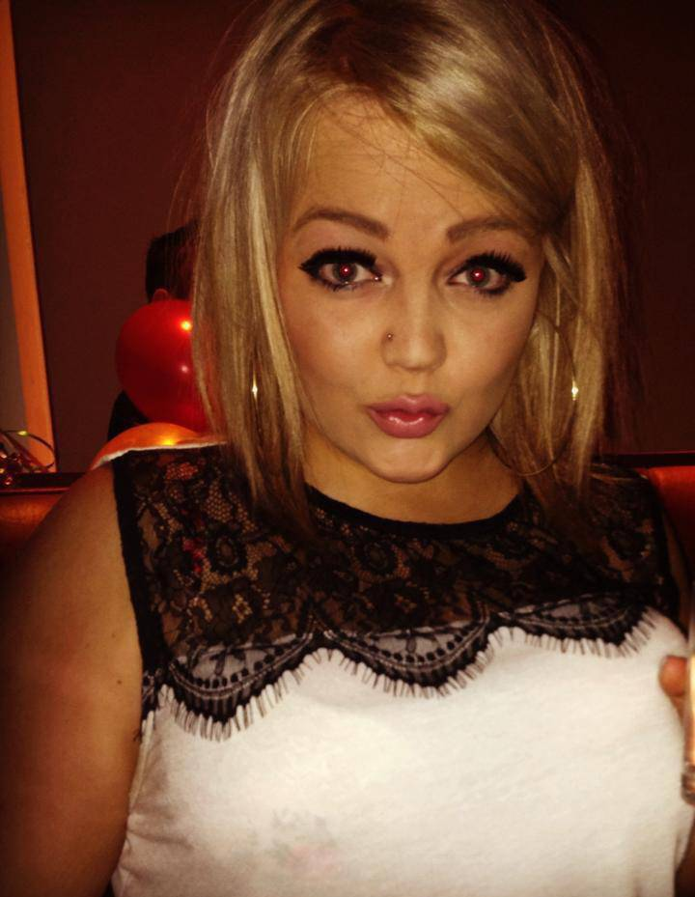
Steph McKay Age: 21
Name Steph McKay
Type Clubber
Role Basic User
Behaviours
Withdraw Amount
Motivations
Only carries her ID and bank card to bars
Sunt in culpa qui officia deserunt mollit anim id est laborum.
Excepteur sint occaecat cupidatat non.
Goals
Quick transactions to get back to drinking
Wants to buy that cute dress next payday
Excepteur sint occaecat cupidatat non.
Pain points
Always in a rush
Tends to forget memories/things from the night before
Loves to spend the little money she makes
Small Denominations
Larger Denominations
Type of use
Bank
ATM
Technology Experience
early-adopter
not-current
“I am always late...good thing I am too cute to wait in lines.”
Current money habits
Saver
Spender
Steph is currently a student and is not worried about saving money at the moment. She loves to go out on weekends to celebrate the end of another school week. She works as a server couple nights of a week. She rarely carries cash on her - she always checks her remaining balance from her spending habits.
Steph prefers to use ATMs and loves they are conveniently located at her favourite places – bars and malls.
Variable description
A behaviour
Opposite behaviour
Variable description
A behaviour
Opposite behaviour

